Slide 1

College of Engineering
Exchange Visitor Training
July 2023

Slide 2
J-1 Exchange Visitor Procedure
Determine the state department and UK categories for the EV
Compose offer letter to EV (templates on the website)
Send link for candidate form to complete
Complete the department information form and submit
Complete COE forms for Faculty Affairs Office or Graduate Services Office send to College Coordinator
Once all documents have been completed and supplemental documents are uploaded, College Coordinator will enter information into iCAT system.

Slide 3
Determining State Department Category
Research Scholar
  An individual who comes to the University primarily to conduct research. Under UK policy the category allows for a maximum 12 month stay. There is a 24-month bar on repeat participation. This means that when the program is completed, the scholar cannot return to the US as a J-1 Research Scholar for a period of two years.

Slide 4
Determining State Department Category
Short-Term Scholar
  An individual who will remain at UK for a maximum duration of six months to conduct research, to teach, or observe. Extensions cannot be granted beyond the six- month period of stay. The short-term scholar is not subject to the 24-month bar on repeat participation

Slide 5
Determining State Department Category
Specialist
  An expert in the field of specialized knowledge or skill who enters the U.S. for the purpose of observing, consulting, or demonstrating expertise (i.e. artist, athlete, visiting coach). The duration of this category is one year with no possibility for extensions.

Slide 6
Determining State Department Category
Student Intern
  Student Intern program participants come to the United States to pursue a structured and guided work-based internship program in their specific academic field. These students are enrolled full-time in a program in their home country and are pursuing an appointment abroad as part of their degree credits.

Slide 7
UK Human Resources Definitions
Postdoctoral Scholar
  An individual who has an earned doctoral degree and is pursuing an individualized program of advanced training in research, in teaching or other aspects of academic work, or any combination of these activities. Although participation in the program provides advanced training, an academic assignment is required as a condition of appointment with salary. A Postdoctoral Scholar is both a temporary academic staff employee and a postdoctoral student. The minimum salary is $47,476/year. The maximum stay is up to 5 years.

Slide 8
UK Human Resources Definitions
Visiting Scholar
  An individual who is pursuing an independent program of research at the University, or is participating in an existing research program, ordinarily while on leave from another professional position. Because of a visiting scholar’s advanced training and experience beyond that of an apprentice or learner, they are excluded from a designation as a postdoctoral scholar or fellow. A visiting scholar need not have a doctoral degree but must have significant scholarly experience. A visiting scholar is temporary academic staff. The visiting scholar must have minimum funding of $22,000/year, from either UK faculty, another source, or a combination. An appointment as a visiting scholar cannot exceed one year.

Slide 9
UK Human Resources Definitions
Visiting Student, Non-Degree
  An individual who is pursuing a degree from another University who is at the University of Kentucky to supplement their degree with their home institution by working with research faculty or taking courses. Visiting student must have a minimum funding of $22,000/year, from either UK faculty another source or a combination. An appointment as a visiting student cannot exceed two years.

Slide 10
J-1 Exchange Visitor Procedure
Visiting Scholars and faculty appointments are covered by AR 5:1 and the Provost Protocol for Appointing Visiting Scholars.
If an exchange visitor is enrolled in any university (even as an ABD PhD. Candidate), follow the instructions for appointing visiting graduate students.
It is important to note the difference between visiting scholars and visiting faculty members. Visiting scholars do research while at UK and DO NOT TEACH, while visiting faculty are primarily assigned teaching responsibilities.
Visiting scholars/faculty members have temporary academic appointments with the University not to exceed one year. Renewals are only accepted for approval by the Provost in rare instances and must be well justified. Visiting scholars/faculty do not typically receive a salary from the University, however as temporary academic staff, they are eligible for some UK benefits, such as a UK ID card, parking permit, and medical insurance. For a complete list of benefits see AR 5:1

Slide 11
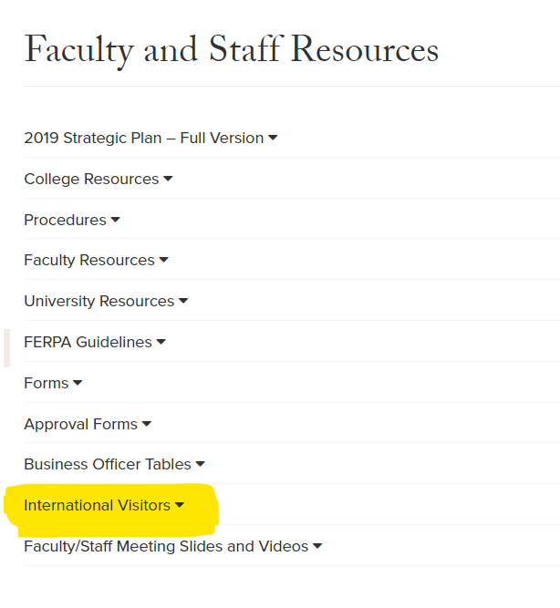
College of Engineering Website

Slide 12
College of Engineering Website
International Visitors
J-1 Scholar Extension
Non-UK Sponsored J-1 (Fullbright Scholar)
H1-B Application
J-1 Exchange Visitor Candidate Information
J-1 Department Information

Slide 13
J-1 Exchange Visitor Procedure
All applications should allow AT LEAST 60 days for processing.
Applications will not be started until all documents and information is received.
All questions regarding a current case or future applicant should be directed to the College Coordinator.

Slide 14
Documents Required for
J-1 EV
  COE Request forms
  Signed Offer Letter
  Visiting Scholar COE Form
  Passport Bio Page
  Proof of Health Insurance
  Documentation of English Proficiency (if required)
  Financial Documentation (if self or partial funded)
  Letter of Endorsement from Home Institution (for student intern)
  COE Undergraduate Form

Slide 15

Questions?
Valerie Pitts
Valerie.pitts@uky.edu
859-323-8890

